Slide 1

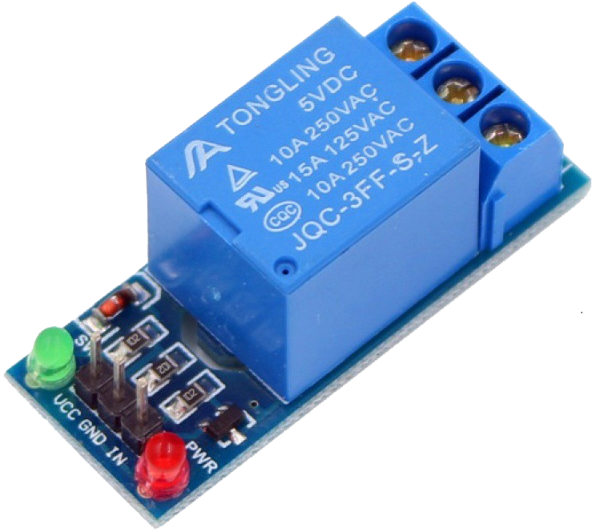
Webinar on Relay module

Slide 2
What is relay module
The Single Channel Relay Module is a convenient board which can be used to control high voltage, high current load such as motor, solenoid valves, lamps and AC load. It is designed to interface with microcontroller such as Arduino, PIC and etc. The relays terminal (COM, NO and NC) is being brought out with screw terminal. It also comes with a LED to indicate the status of relay.

Slide 3
Specification-
Digital output controllable
Compatible with any 5V microcontroller such as Arduino.
Rated through-current: 10A (NO) 5A (NC)
Control signal: TTL level
Max. switching voltage 250VAC/30VDC
Max. switching current 10A
Size: 43mm x 17mm x 17mm

Slide 4
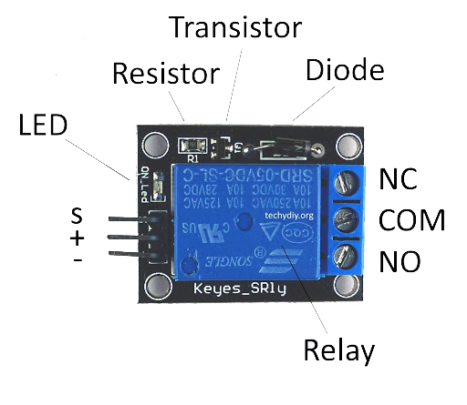
Pin diagram of relay module

Slide 5
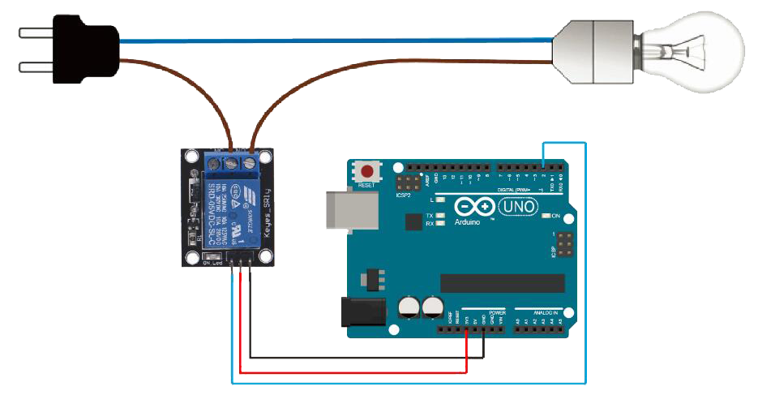
How to use relay module with arduino

Slide 6
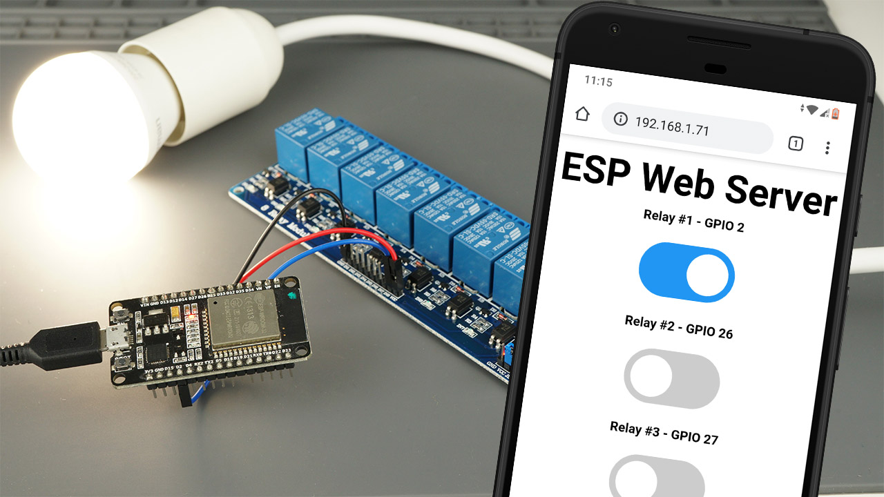
Project by using relay module
HOME AUTOMATION BY USING REALY MODULE

Slide 7
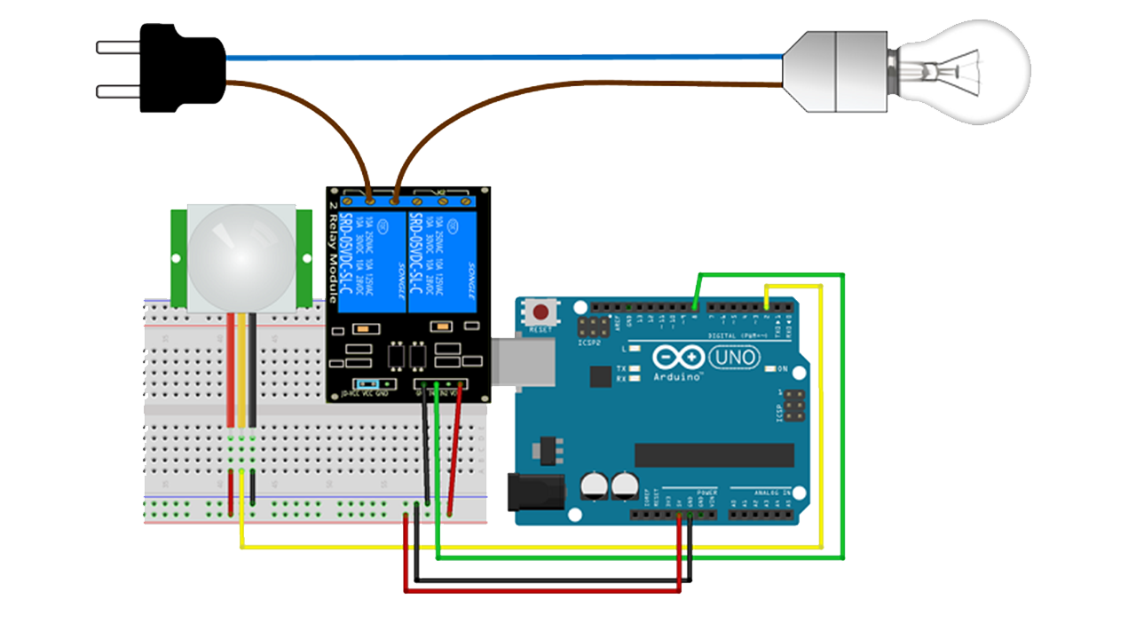
Pir sensor with relay module

Slide 8
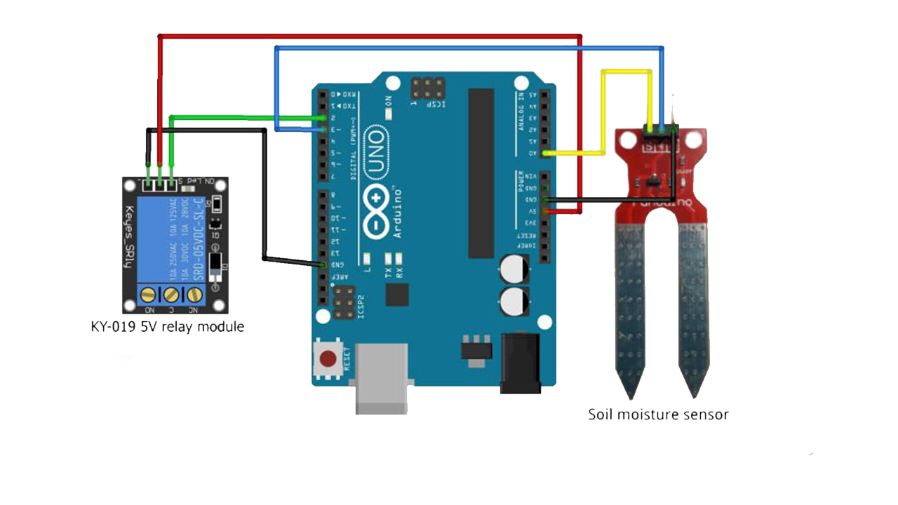
Soil moisture sensor with relay module

Slide 9
Advantages of relay module
It allows to control a remote device. It is not necessary to be near the device to make it work.
Change contacts easily.
Isolates the activating part of the actuating part.
It works well at high temperatures.
It is activated with low current, however it can activate large machines of great power.
With a single signal you can control several contacts at once.
It can switch direct current or alternating current.

Slide 10
APPLICATION OF RELAY MODULE -
1-DIGITAL HOUSEHOLD ELECTRICAL APPLIANCES
2-INDUSTRIAL EQUIPMENT
3-MEDICAL DEVICES
4-SECURITY DEVICES
5-AGRICULTURE FIELD
6-SECURITY DEVICES
7-AUTOMOBILE INDUSTRY

Slide 11
THANK YOU

